Slide 1

NARROGIN SENIOR HIGH SCHOOL
Department of Crime Investigation
Welcome Detectives
Thank you for your attendance
Please take a seat
Notes:
Welcome Detectives
“Welcome Detectives – can we start with a roll call to ensure everybody is here?”
Roll Call by preceding each student’s name with “Detective”
“I appreciate you all have busy schedules and important cases you are working on and I would like to thank you all for coming down today”
“You have all been hand picked by me due to your renowned investigative skills and expertise”
“I know you weren’t given much information so I would like to fill you in on while you have all been gathered here today”
“ We have cold case that needs fresh young eyes”
“We want you all to investigate the evidence and existing theories and present three of your best case scenarios concerning the case of death in this case”
“You are welcome to present a new theory of your own, and in fact are encouraged to do so, however it must be based on the evidence and on scientific fact.”
“So lets look at the crime scene”

Slide 2
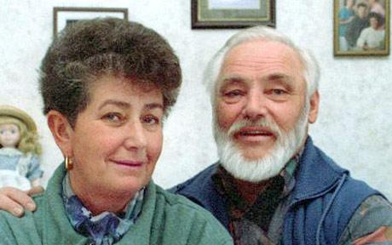
Erika and Helmut Simon
http://i.telegraph.co.uk/multimedia/archive/01000/Oetzi-460_1000996c.jpg

Slide 3
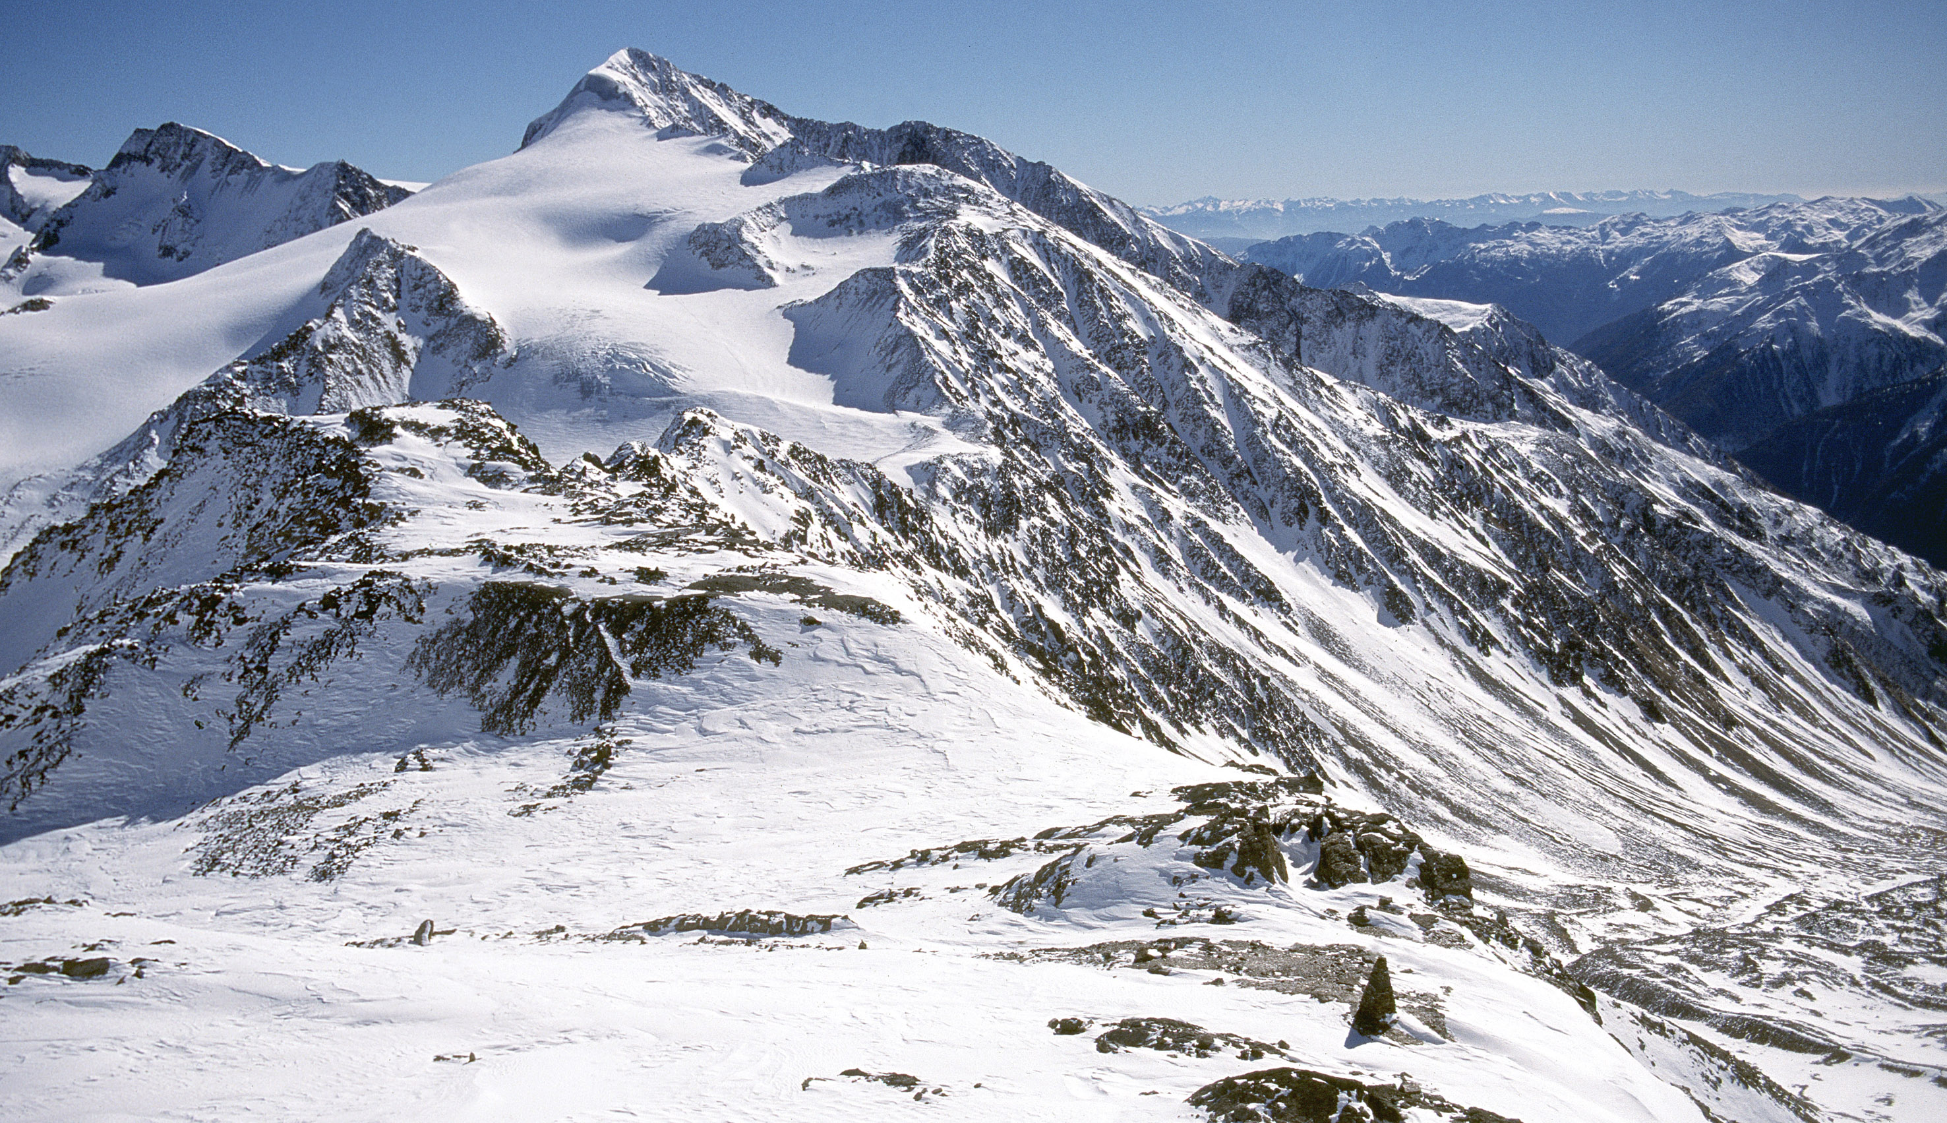
Otzal Alps
http://www.iceman.it/en/oetzi-the-iceman

Slide 4
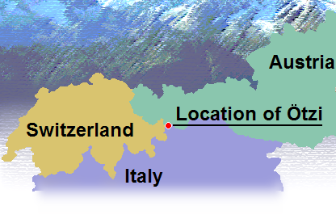
http://queerstoryfiles.blogspot.com.au/2013_04_01_archive.html

Slide 5
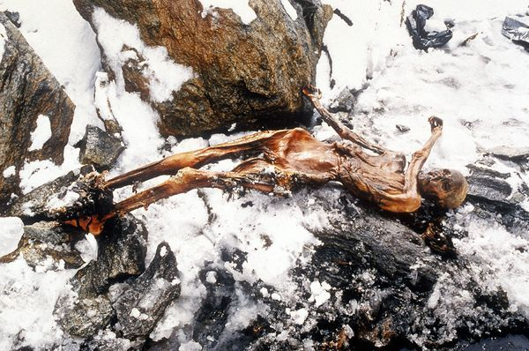
http://www.iceman.it/en/oetzi-the-iceman
Notes:
On Thursday September 19th, two hikers, hiking in the Otzal Alps between the borders of Austria and Italy discovered this body.

Slide 6
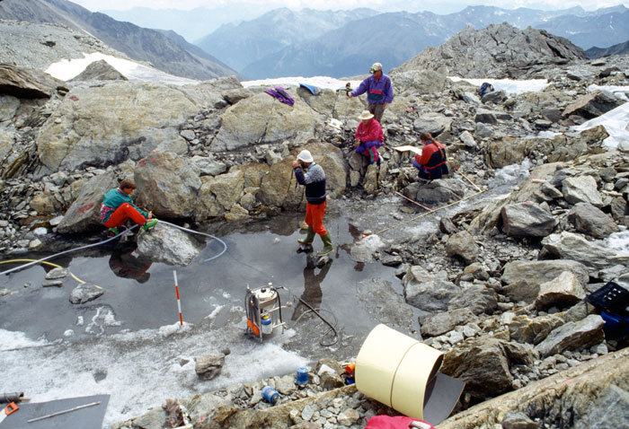
http://www.iceman.it/en/oetzi-the-iceman

Slide 7
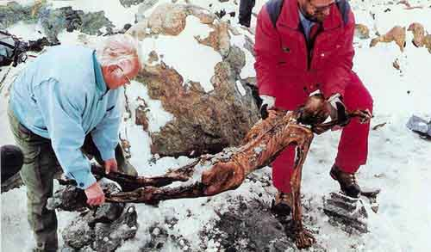
http://www.iceman.it/en/oetzi-the-iceman
Notes:
Welcome Detectives
“Welcome Detectives – can we start with a roll call to ensure everybody is here?”
Roll Call by preceding each student’s name with “Detective”
“I appreciate you all have busy schedules and important cases you are working on and I would like to thank you all for offering you skills and expertise to enable us to solve the mystery around this particular crime scene”

Slide 8
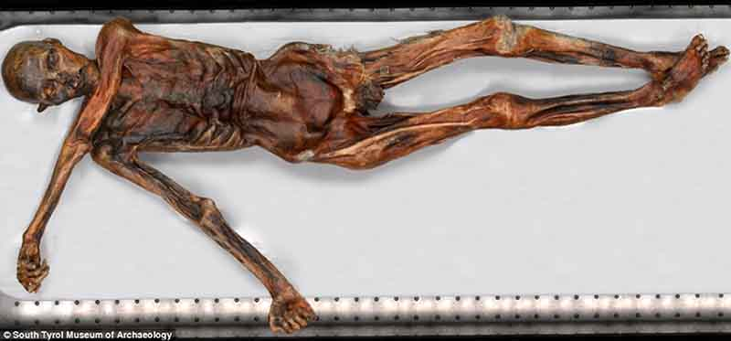
http://www.iceman.it/en/oetzi-the-iceman
http://www.iceman.it/en/oetzi-the-iceman

Slide 9
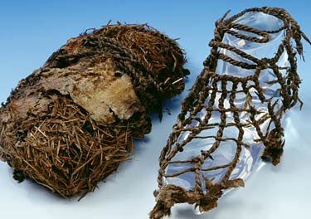
http://www.iceman.it/en/oetzi-the-iceman

Slide 10
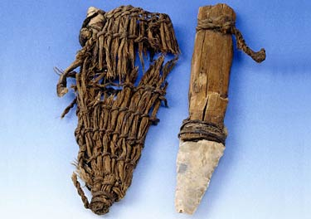
http://www.iceman.it/en/oetzi-the-iceman

Slide 11
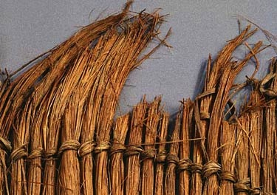
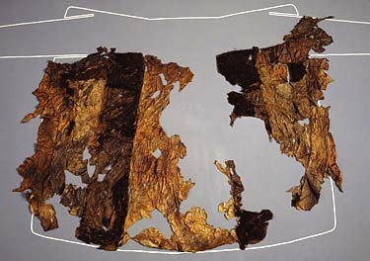
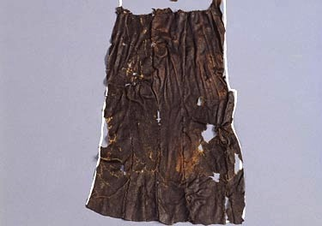
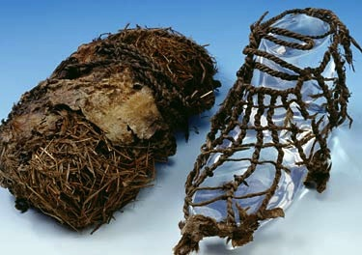
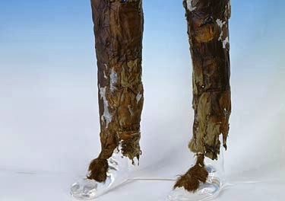
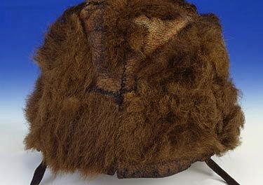
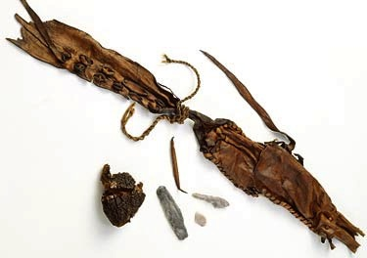
Clothing
http://www.iceman.it/en/oetzi-the-iceman

Slide 12
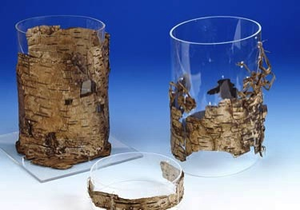
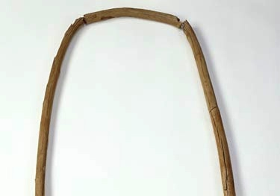
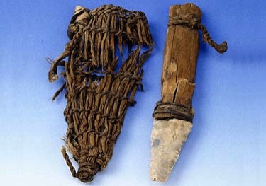
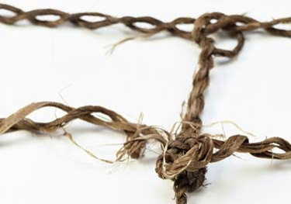
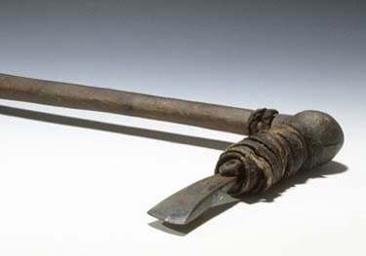
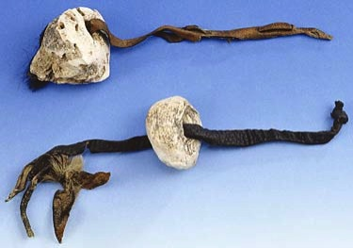
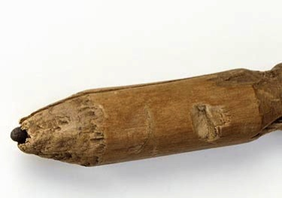
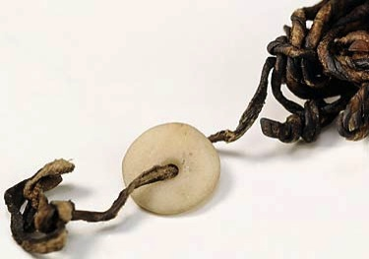
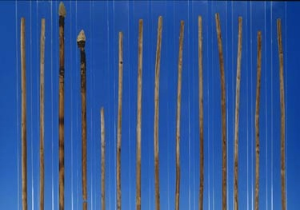
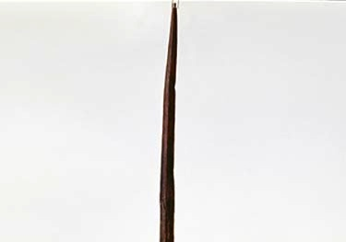
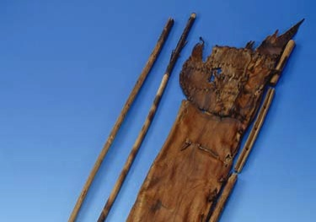
Equipment
http://www.iceman.it/en/oetzi-the-iceman

Slide 13
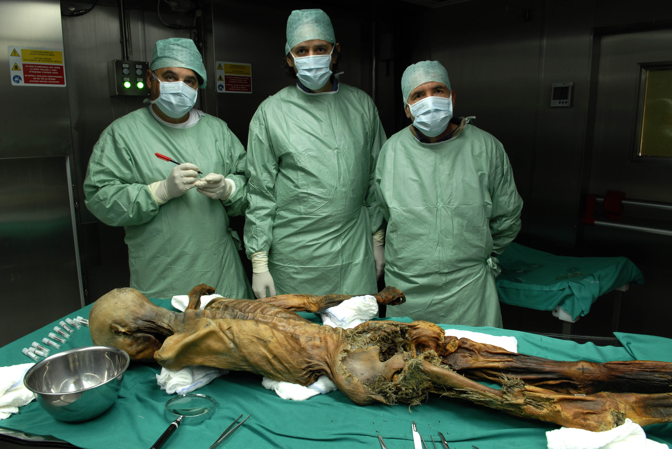
http://www.iceman.it/en/oetzi-the-iceman

